Slide 1
Data warehouse
Introduction to dimensionality

Slide 2
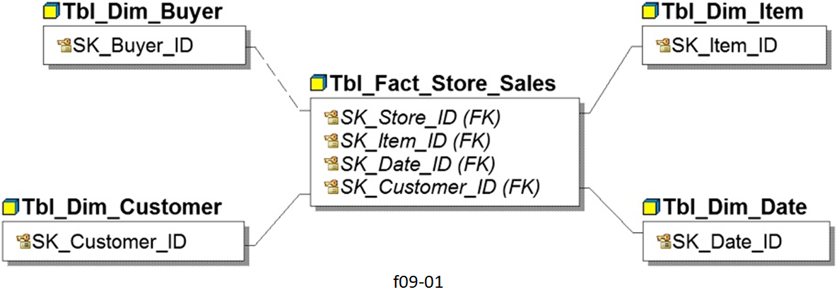
What is a Dimensional Model?
A dimensional model is a data structure technique optimized for Data warehousing tools.

Slide 3
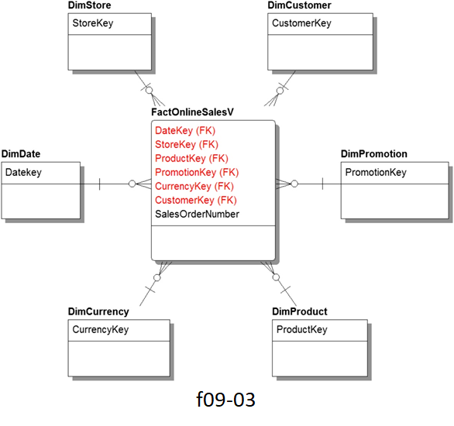
Elements of Dimensional Data Model
Facts: measurements/metrics or facts from your business process; i.e a measurement would be quarterly sales number
Fact Table: a primary table in a dimensional model.It contains:
Measurements/facts
Foreign key to dimension table

Slide 4
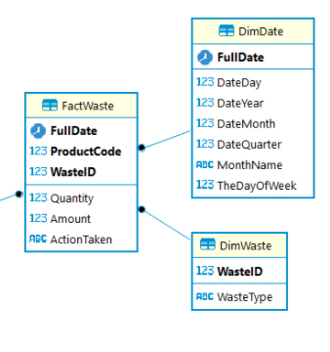
Granularity
One of the most important subjects of DW.
A fact table aggregates its measurements based on the granularity of its dimensions.

Slide 5
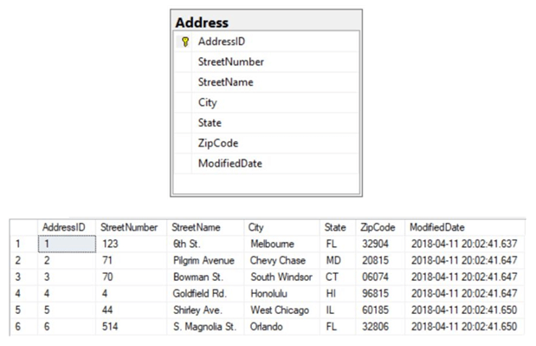
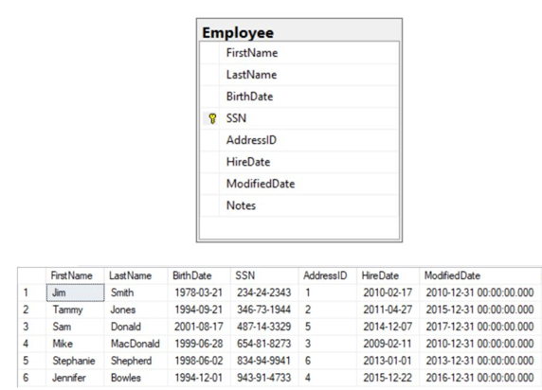
Surrogate & natural keys
A surrogate key is a system generated value with no business meaning.
A natural key is a column or set of columns that already exist in the table.

Slide 6
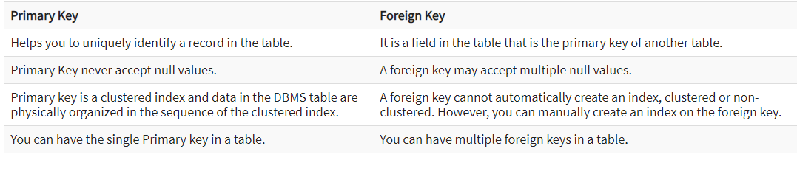
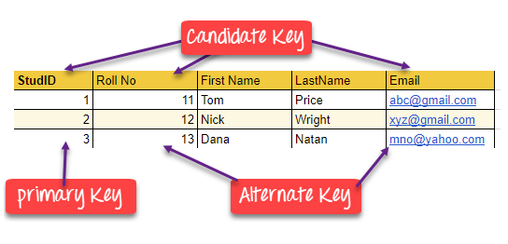
Differences between primary & foreign keys

Slide 7
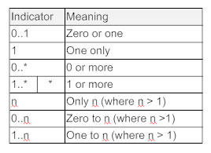
Cardinality
Define a limit on the number of links with other objects an object can participate in.
These numbers of links are called cardinality: they reflect the enterprise rules (constraints).

Slide 8
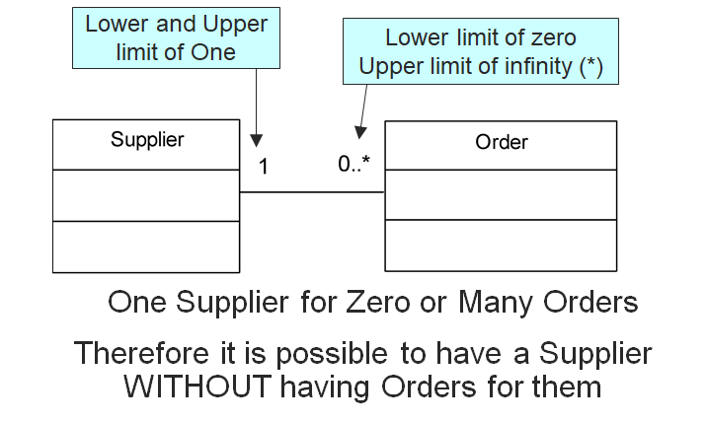
Cardinality example

Slide 9
Elements of Dimensional Data Model.
Dimension: provides the context surrounding a business process event. In simple terms, they give who, what, where of a fact; i.e. Location, Customer name, product category
Attributes: the various characteristics of the dimension; i.e. County, Country
Attributes are used to search, filter, or classify facts. Dimension Tables contain Attributes

Slide 10
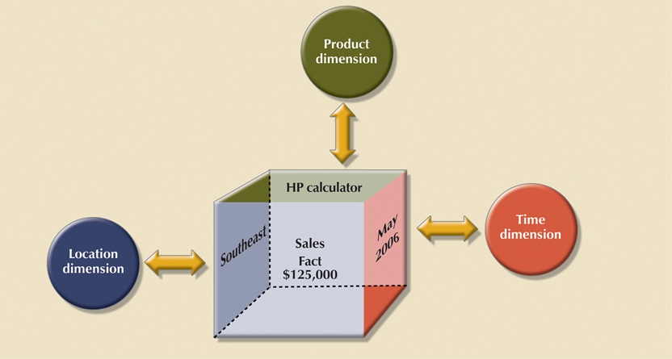
Dimensions
Dimensions provide descriptive characteristics about the facts through their attributes

Slide 11
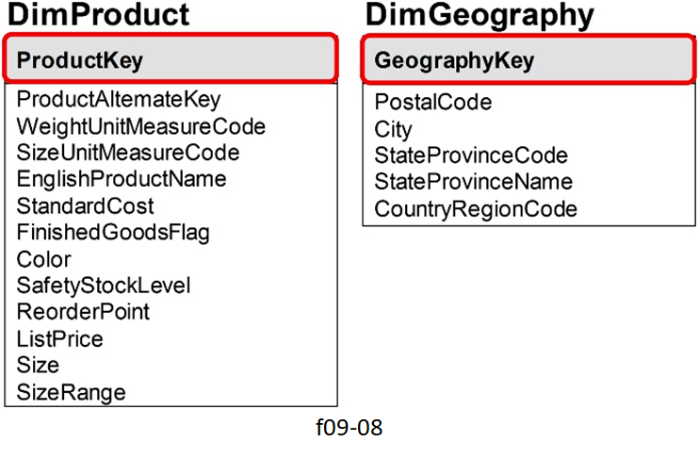
Dimension examples

